Slide 1
9th CII-EXIM Bank Conclave on INDIA-AFRICA Project Partnership

Slide 2
THE MKU EDGE… an introduction
MKU is a leader in the ballistic protection and surveillance sector.
Over 25 years of experience in protecting people and platforms
State of the art Infrastructure in India and Germany
Footprint in more than 90 countries worldwide
Ahead of the curve, proven technology

Slide 3
CERTIFIED AND TRUSTED SOLUTIONS
Registered supplier
NATO
UN
Certified Quality Management Systems
AS 9100:2004 (Aircraft Armoring)
ISO 9001:2008
ISO 14001 (Environmental Management System)
Products certified by the leading names in the world:
National Institute of Justice (NIJ), US
H.P. White Laboratory, USA
Mellrichstadt, Germany
TNO, Netherlands
DRDO, India

Slide 4
Personal Protection
Vehicle Protection
Special Projects Division
Electro Optics
PRODUCT VERTICALS
Global market
Domestic market

Slide 5
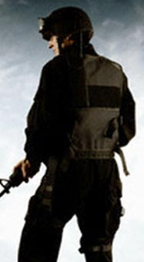
Personal Protection
Ballistic Helmets
Ballistic Jackets
Armor Inserts
Demining Suits
Bomb Blankets
Ballistic Shields

Slide 6
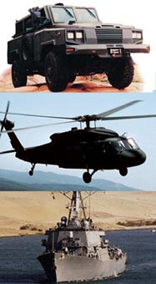
Vehicle Protection
of light weight armouring solutions for:
LAND VEHCLES
AIRCRAFT
NAVAL VESSELS
OBJECTS
Design > Development > Manufacturing > Integration

Slide 7
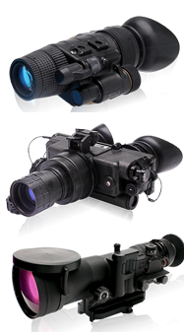
Electro Optics
Night Vision Bincoulars
Night Vision Monoculars
Night Vision Sights
Day Optic Devices
NIGHT VISION DEVICES

Slide 8
AFRICA – AN OVERVIEW
GAIN THE EDGE.

Slide 9
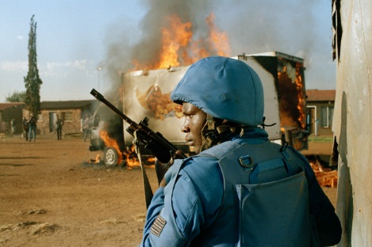
AFRICA – LAW AND ORDER SCENARIOS
TYPICAL THREATS
Terrorist infiltration & insurgencies
Internal Conflicts
High Sea Piracy
Civil War situations.
VIP Security

Slide 10
AFRICA – LAW AND ORDER SCENARIOS
CHALLENGES
Maintaining Law & Order in Urban Scenarios, trickier than combat zones:
Threats not identifiable from within masses
Difficult to distinguish between friends & foes
Minimising collateral damage (Property & human)

Slide 11
INDO – AFRICA POSSIBLE AREAS OF ASSOCIATION FOR LAW & ORDER CONTROL
GAIN THE EDGE.

Slide 12
Reputed Customers –Intl.
Client base in over 90 countries
America Key End-users
Europe Key End-users
Asia Pacific Key End-users
MEA Key End-users
Army, Mexico
Federal Police, Mexico
Army, Brazil
Navy, Chile
Police, Chile
National Police, Colombia
INPEC, Colombia
Army, Peru
Air Force, Peru
National Police, Venezuela
Army, Ecuador
National Police, Ecuador
Ministry of Defense, UK
MOI, Italy
Police, Italy
MOD, Italy
Army, Portugal
MOD, Bosnia
Min. of Civil Affairs, Bosnia
Police, Germany
MOD, Turkey
S&D Dept., France
Army, Bulgaria
MOD, India
MHA, India
Civil Def. Force , Singapore
Victoria Police, Australia
Armed Police, China
National Police, Afghanistan
Army, Afghanistan
Defense forces, Indonesia
Min. of Public Sec., Vietnam
MOI, Kazakhstan
Ministry of Interior, Egypt
Deptt. of Public Security, Saudi Arabia
Border Guards, Saudi Arabia
Police Services, Ghana,
Ministry of Defense, Algeria
MOI, Tunisia
Police Services, Botswana
MOI, Burkina Faso
Army, Benin
Customer locations

Slide 13
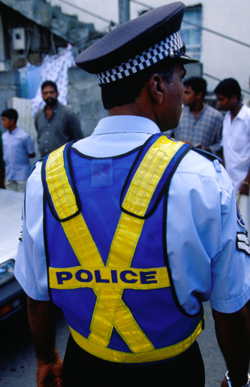
MKU OFFERS ASSOCIATION THROUGH
Representation
Distributorship
Joint Ventures
Direct Sales
Transfer of Technology

Slide 14
PLEASE FEEL FREE TO VISIT US AT OUR BOOTH IN SHAHEJAHAN HALL
sharad.khandelwal@mku.com
+91 9935415552
www.mku.com
13, Gandhi Gram, Kanpur (UP) INDIA | Phone: +91 512 3026700

